Slide 1
Virtual Machines
Chapter 18 of Operating System Concepts, Global edition

Slide 2
Outline
Overview
History
Benefits and Features
Types of Virtual Machines and Their Implementations
Virtualization and Operating-System Components
Examples

Slide 3
Virtual machines
System programs above kernel can use either system calls or hardware instructions.
System programs treat the hardware and the system calls as though they both are at the same level.
In general application programs may view everything under them in the hierarchy as a part of machine itself, which leads to the concept of virtual machines..
The virtual machine approach provides an interface that is identical to the underlying bare hardware.
Each process is provided with a (virtual) copy of the underlying computer.
The resources of the physical computer are shared to create the virtual machines.
CPU scheduling and spooling are used.

Slide 4
Structure view: Virtual machines
Logical conclusion of layered approach.
The OS offers an abstract machine to execute on
Hides the specifics and details of hardware
Users are given their own VM, they can run any of the OS or software packages that are available on the underlying machine.
Provides a complete copy of underlying machine to the user
Pioneered under the name virtual machine (VM) by IBM
Became a household name with JAVA
Mechanism of creating this illusion
CPU scheduling
Sharing the CPU in a transparent way
Memory management
Having large virtual memory space to address
Additional features such as file systems and so on are offered through file management subsystems
Problem is with partitioning the disk
VM introduced minidisks such partitioning of tracks on the physical disk.

Slide 5
Types of multiplexing
Time multiplexing
time-sharing
scheduling a serially-reusable resource among several users
Space multiplexing
space-sharing
dividing a multiple-use resource up among several users

Slide 6
Virtual computers
Processor virtualized to processes
mainly time-multiplexing
Memory virtualized to address spaces
space and time multiplexing
Disks virtualized to files
space-multiplexing
transforming

Slide 7
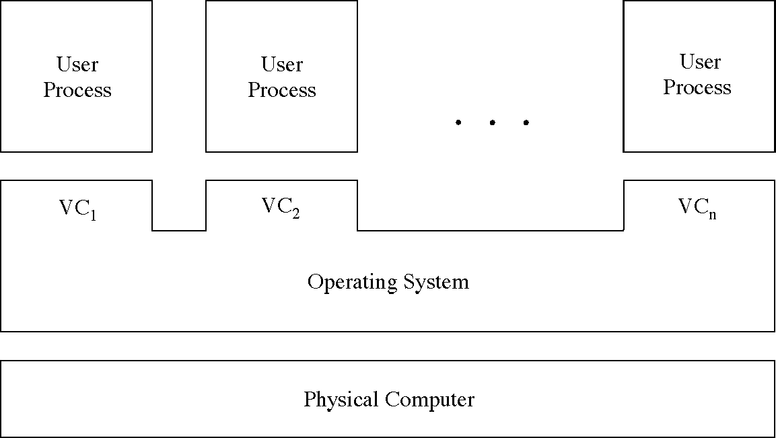
Multiple virtual computers

Slide 8
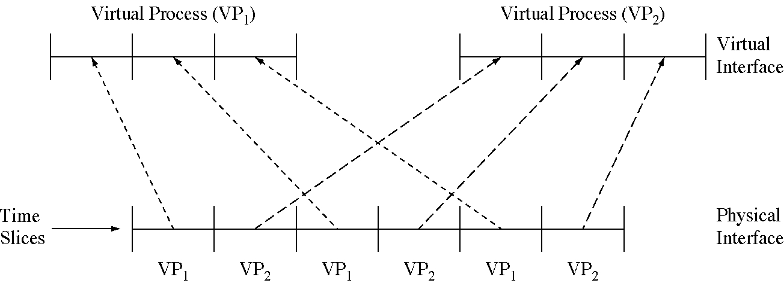
Time-multiplexing the processor

Slide 9
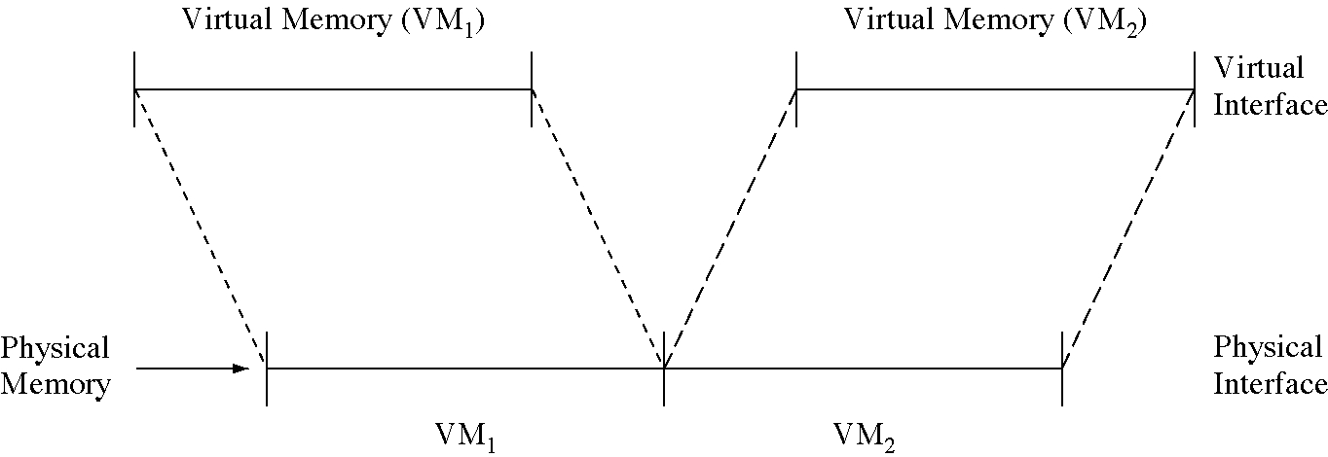
Space-multiplexing memory

Slide 10
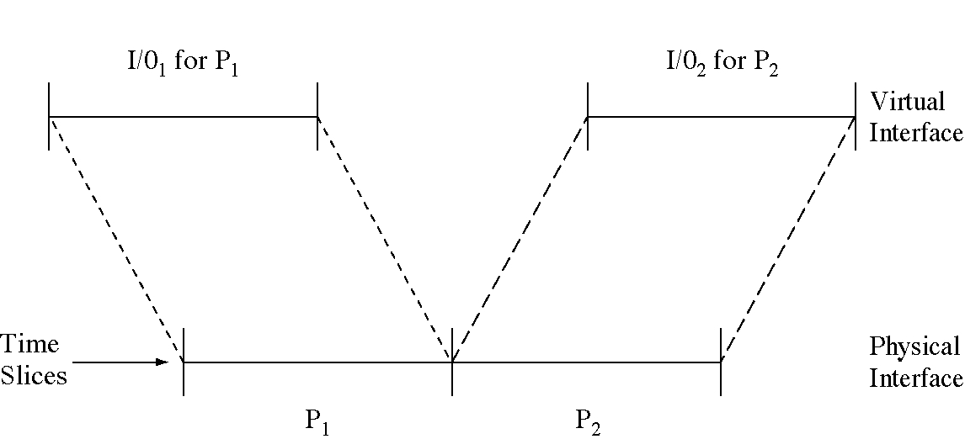
Time-multiplexing I/O devices

Slide 11
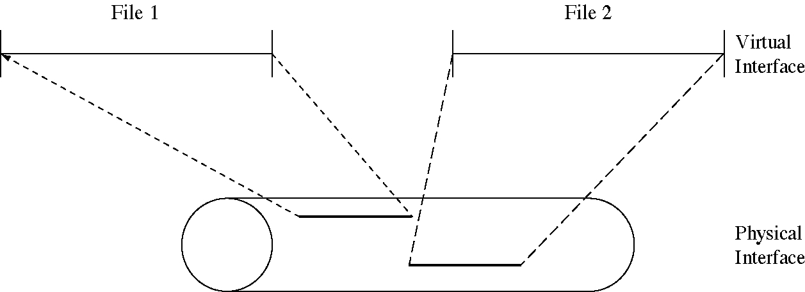
Space-multiplexing the disk

Slide 12
Virtual Machines: Overview
Fundamental idea – abstract hardware of a single computer into several different execution environments
Similar to layered approach
But layer creates virtual system (virtual machine, or VM) on which operation systems or applications can run
Several components
Host – underlying hardware system
Virtual machine manager (VMM) or hypervisor – creates and runs virtual machines by providing interface that is identical to the host
(Except in the case of paravirtualization)
Guest – process provided with virtual copy of the host
Usually an operating system
Single physical machine can run multiple operating systems concurrently, each in its own virtual machine

Slide 13
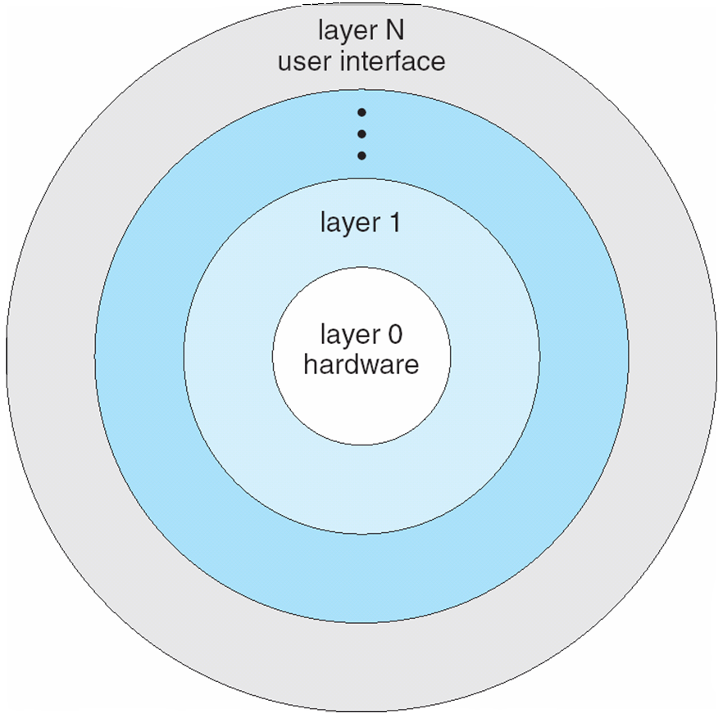
Layered Operating System
Notes:
13

Slide 14
System Models
Non-virtual machine
Virtual machine

Slide 15
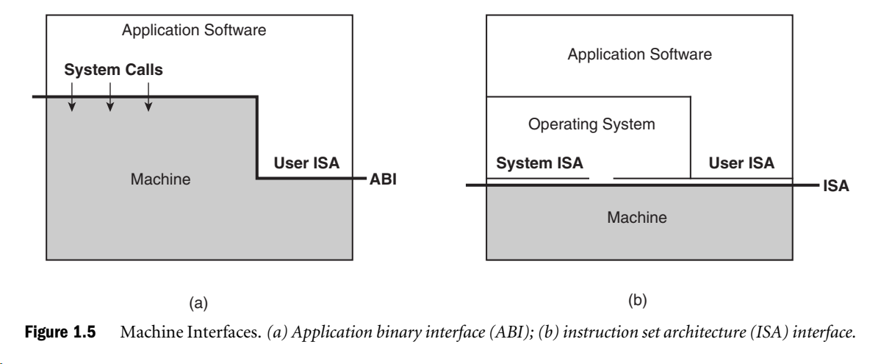

Slide 16
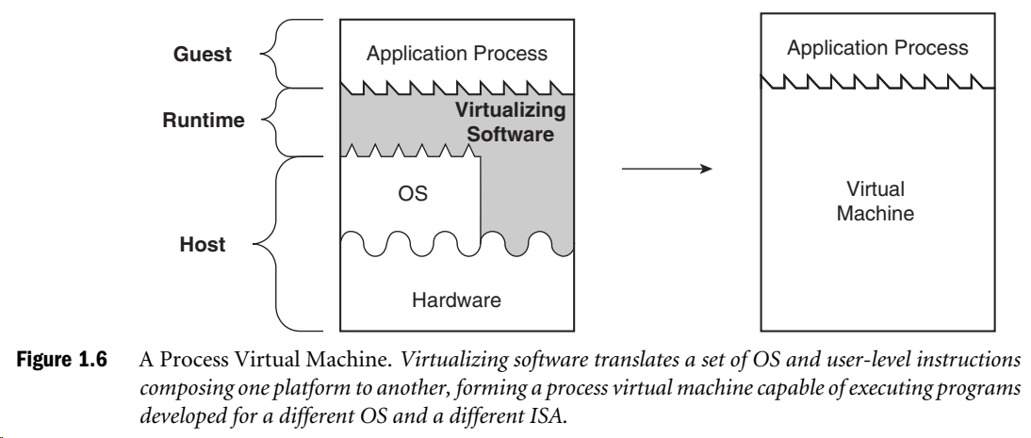

Slide 17
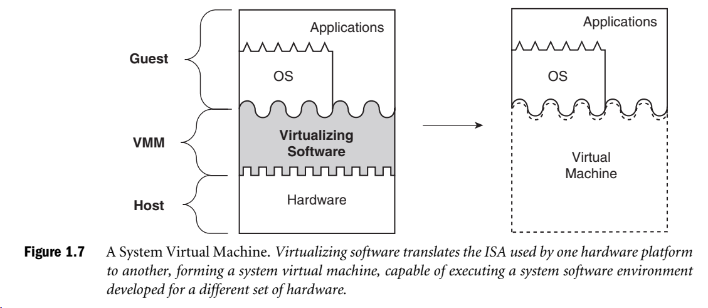

Slide 18
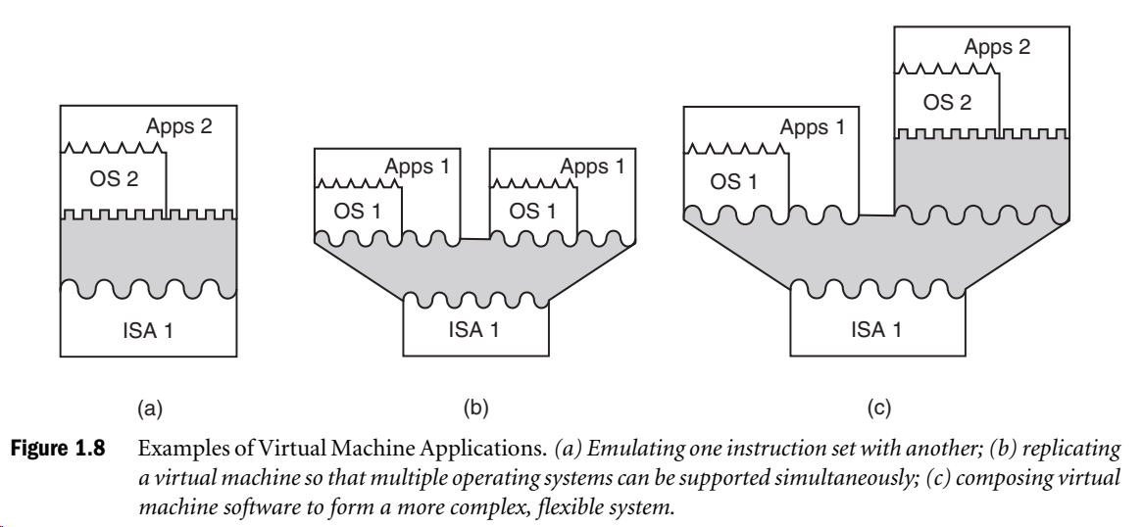

Slide 19
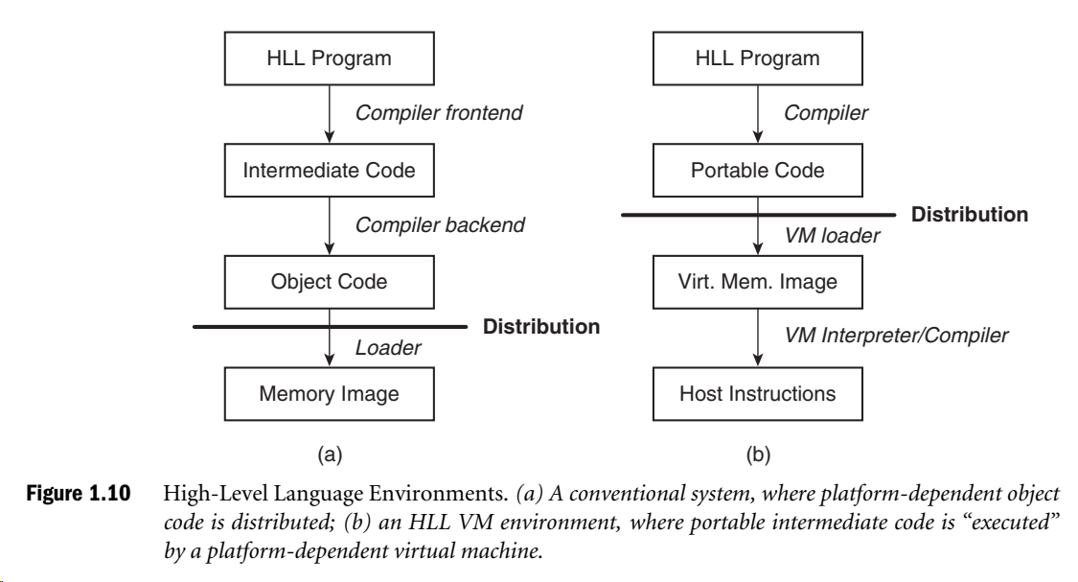

Slide 20
Implementation of VMMs
Vary greatly, with options including:
Type 0 hypervisors - Hardware-based solutions that provide support for virtual machine creation and management via firmware
IBM LPARs and Oracle LDOMs are examples
Type 1 hypervisors - Operating-system-like software built to provide virtualization
Including VMware ESX, Joyent SmartOS, and Citrix XenServer
Type 1 hypervisors – Also includes general-purpose operating systems that provide standard functions as well as VMM functions
Including Microsoft Windows Server with HyperV and RedHat Linux with KVM
Type 2 hypervisors - Applications that run on standard operating systems but provide VMM features to guest operating systems
Includeing VMware Workstation and Fusion, Parallels Desktop, and Oracle VirtualBox

Slide 21
Implementation of VMMs (cont.)
Other variations include:
Paravirtualization - Technique in which the guest operating system is modified to work in cooperation with the VMM to optimize performance
Programming-environment virtualization - VMMs do not virtualize real hardware but instead create an optimized virtual system
Used by Oracle Java and Microsoft.Net
Emulators – Allow applications written for one hardware environment to run on a very different hardware environment, such as a different type of CPU
Application containment - Not virtualization at all but rather provides virtualization-like features by segregating applications from the operating system, making them more secure, manageable
Including Oracle Solaris Zones, BSD Jails, and IBM AIX WPARs
Much variation due to breadth, depth and importance of virtualization in modern computing

Slide 22
History
First appeared in IBM mainframes in 1972
Allowed multiple users to share a batch-oriented system
Formal definition of virtualization helped move it beyond IBM
A VMM provides an environment for programs that is essentially identical to the original machine
Programs running within that environment show only minor performance decreases
The VMM is in complete control of system resources
In late 1990s Intel CPUs fast enough for researchers to try virtualizing on general purpose PCs
Xen and VMware created technologies, still used today
Virtualization has expanded to many OSes, CPUs, VMMs

Slide 23
Benefits and Features
Host system protected from VMs, VMs protected from each other
i.e. A virus less likely to spread
Sharing is provided though via shared file system volume, network communication
Freeze, suspend, running VM
Then can move or copy somewhere else and resume
Snapshot of a given state, able to restore back to that state
Some VMMs allow multiple snapshots per VM
Clone by creating copy and running both original and copy
Great for OS research, better system development efficiency
Run multiple, different OSes on a single machine
Consolidation, app dev, …

Slide 24
Benefits and Features (cont.)
Templating – create an OS + application VM, provide it to customers, use it to create multiple instances of that combination
Live migration – move a running VM from one host to another!
No interruption of user access
All those features taken together -> cloud computing
Using APIs, programs tell cloud infrastructure (servers, networking, storage) to create new guests, VMs, virtual desktops

Slide 25
Types of Virtual Machines and Implementations
Many variations as well as HW details
Assume VMMs take advantage of HW features
HW features can simplify implementation, improve performance
Whatever the type, a VM has a lifecycle
Created by VMM
Resources assigned to it (number of cores, amount of memory, networking details, storage details)
In type 0 hypervisor, resources usually dedicated
Other types dedicate or share resources, or a mix
When no longer needed, VM can be deleted, freeing resources
Steps simpler, faster than with a physical machine install
Can lead to virtual machine sprawl with lots of VMs, history and state difficult to track

Slide 26
Types of VMs – Type 0 Hypervisor
Old idea, under many names by HW manufacturers
“partitions”, “domains”
A HW feature implemented by firmware
OS need to nothing special, VMM is in firmware
Smaller feature set than other types
Each guest has dedicated HW
I/O a challenge as difficult to have enough devices, controllers to dedicate to each guest
Sometimes VMM implements a control partition running daemons that other guests communicate with for shared I/O
Can provide virtualization-within-virtualization (guest itself can be a VMM with guests
Other types have difficulty doing this

Slide 27
Type 0 Hypervisor

Slide 28
Types of VMs – Type 1 Hypervisor
Commonly found in company datacenters
In a sense becoming “datacenter operating systems”
Datacenter managers control and manage OSes in new, sophisticated ways by controlling the Type 1 hypervisor
Consolidation of multiple OSes and apps onto less HW
Move guests between systems to balance performance
Snapshots and cloning
Special purpose operating systems that run natively on HW
Rather than providing system call interface, create run and manage guest OSes
Can run on Type 0 hypervisors but not on other Type 1s
Run in kernel mode
Guests generally don’t know they are running in a VM
Implement device drivers for host HW because no other component can
Also provide other traditional OS services like CPU and memory management

Slide 29
Types of VMs – Type 1 Hypervisor (cont.)
Another variation is a general purpose OS that also provides VMM functionality
RedHat Enterprise Linux with KVM, Windows with Hyper-V, Oracle Solaris
Perform normal duties as well as VMM duties
Typically less feature rich than dedicated Type 1 hypervisors
In many ways, treat guests OSes as just another process
Albeit with special handling when guest tries to execute special instructions

Slide 30
Types of VMs – Type 2 Hypervisor
Less interesting from an OS perspective
Very little OS involvement in virtualization
VMM is simply another process, run and managed by host
Even the host doesn’t know they are a VMM running guests
Tend to have poorer overall performance because can’t take advantage of some HW features
But also a benefit because require no changes to host OS
Student could have Type 2 hypervisor on native host, run multiple guests, all on standard host OS such as Windows, Linux, MacOS

Slide 31
Types of VMs – Paravirtualization
Does not fit the definition of virtualization – VMM not presenting an exact duplication of underlying hardware
But still useful!
VMM provides services that guest must be modified to use
Leads to increased performance
Less needed as hardware support for VMs grows
Xen, leader in paravirtualized space, adds several techniques
For example, clean and simple device abstractions
Efficient I/O
Good communication between guest and VMM about device I/O
Each device has circular buffer shared by guest and VMM via shared memory

Slide 32
Xen I/O via Shared Circular Buffer

Slide 33
Types of VMs – Paravirtualization (cont.)
Xen, leader in paravirtualized space, adds several techniques (Cont.)
Memory management does not include nested page tables
Each guest has own read-only tables
Guest uses hypercall (call to hypervisor) when page-table changes needed
Paravirtualization allowed virtualization of older x86 CPUs (and others) without binary translation
Guest had to be modified to use run on paravirtualized VMM
But on modern CPUs Xen no longer requires guest modification -> no longer paravirtualization

Slide 34
Types of VMs – Programming Environment Virtualization
Also not-really-virtualization but using same techniques, providing similar features
Programming language is designed to run within custom-built virtualized environment
For example Oracle Java has many features that depend on running in Java Virtual Machine (JVM)
In this case virtualization is defined as providing APIs that define a set of features made available to a language and programs written in that language to provide an improved execution environment
JVM compiled to run on many systems (including some smart phones even)
Programs written in Java run in the JVM no matter the underlying system
Similar to interpreted languages

Slide 35
Types of VMs – Emulation
Another (older) way for running one operating system on a different operating system
Virtualization requires underlying CPU to be same as guest was compiled for
Emulation allows guest to run on different CPU
Necessary to translate all guest instructions from guest CPU to native CPU
Emulation, not virtualization
Useful when host system has one architecture, guest compiled for other architecture
Company replacing outdated servers with new servers containing different CPU architecture, but still want to run old applications
Performance challenge – order of magnitude slower than native code
New machines faster than older machines so can reduce slowdown
Very popular – especially in gaming where old consoles emulated on new

Slide 36
Types of VMs – Application Containment
Some goals of virtualization are segregation of apps, performance and resource management, easy start, stop, move, and management of them
Can do those things without full-fledged virtualization
If applications compiled for the host operating system, don’t need full virtualization to meet these goals
Oracle containers / zones for example create virtual layer between OS and apps
Only one kernel running – host OS
OS and devices are virtualized, providing resources within zone with impression that they are only processes on system
Each zone has its own applications; networking stack, addresses, and ports; user accounts, etc
CPU and memory resources divided between zones
Zone can have its own scheduler to use those resources

Slide 37
Solaris 10 with Two Zones

Slide 38
Virtualization and Operating-System Components
Now look at operating system aspects of virtualization
CPU scheduling, memory management, I/O, storage, and unique VM migration feature
How do VMMs schedule CPU use when guests believe they have dedicated CPUs?
How can memory management work when many guests require large amounts of memory?

Slide 39
OS Component – CPU Scheduling
Even single-CPU systems act like multiprocessor ones when virtualized
One or more virtual CPUs per guest
Generally VMM has one or more physical CPUs and number of threads to run on them
Guests configured with certain number of VCPUs
Can be adjusted throughout life of VM
When enough CPUs for all guests -> VMM can allocate dedicated CPUs, each guest much like native operating system managing its CPUs
Usually not enough CPUs -> CPU overcommitment
VMM can use standard scheduling algorithms to put threads on CPUs
Some add fairness aspect

Slide 40
OS Component – CPU Scheduling (cont.)
Cycle stealing by VMM and oversubscription of CPUs means guests don’t get CPU cycles they expect
Consider timesharing scheduler in a guest trying to schedule 100ms time slices -> each may take 100ms, 1 second, or longer
Poor response times for users of guest
Time-of-day clocks incorrect
Some VMMs provide application to run in each guest to fix time-of-day and provide other integration features

Slide 41
OS Component – Memory Management
Also suffers from oversubscription -> requires extra management efficiency from VMM
For example, VMware ESX guests have a configured amount of physical memory, then ESX uses 3 methods of memory management
Double-paging, in which the guest page table indicates a page is in a physical frame but the VMM moves some of those pages to backing store
Install a pseudo-device driver in each guest (it looks like a device driver to the guest kernel but really just adds kernel-mode code to the guest)
Balloon memory manager communicates with VMM and is told to allocate or deallocate memory to decrease or increase physical memory use of guest, causing guest OS to free or have more memory available
Deduplication by VMM determining if same page loaded more than once, memory mapping the same page into multiple guests

Slide 42
OS Component – I/O
Easier for VMMs to integrate with guests because I/O has lots of variation
Already somewhat segregated / flexible via device drivers
VMM can provide new devices and device drivers
But overall I/O is complicated for VMMs
Many short paths for I/O in standard OSes for improved performance
Less hypervisor needs to do for I/O for guests, the better
Possibilities include direct device access, DMA pass-through, direct interrupt delivery
Again, HW support needed for these
Networking also complex as VMM and guests all need network access
VMM can bridge guest to network (allowing direct access)
And / or provide network address translation (NAT)
NAT address local to machine on which guest is running, VMM provides address translation to guest to hide its address

Slide 43
OS Component – Storage Management
Both boot disk and general data access need be provided by VMM
Need to support potentially dozens of guests per VMM (so standard disk partitioning not sufficient)
Type 1 – storage guest root disks and config information within file system provided by VMM as a disk image
Type 2 – store as files in file system provided by host OS
Duplicate file -> create new guest
Move file to another system -> move guest
Physical-to-virtual (P-to-V) convert native disk blocks into VMM format
Virtual-to-physical (V-to-P) convert from virtual format to native or disk format
VMM also needs to provide access to network attached storage (just networking) and other disk images, disk partitions, disks, etc

Slide 44
OS Component – Live Migration
Taking advantage of VMM features leads to new functionality not found on general operating systems such as live migration
Running guest can be moved between systems, without interrupting user access to the guest or its apps
Very useful for resource management, maintenance downtime windows, etc
The source VMM establishes a connection with the target VMM
The target creates a new guest by creating a new VCPU, etc
The source sends all read-only guest memory pages to the target
The source sends all read-write pages to the target, marking them as clean
The source repeats step 4, as during that step some pages were probably modified by the guest and are now dirty
When cycle of steps 4 and 5 becomes very short, source VMM freezes guest, sends VCPU’s final state, sends other state details, sends final dirty pages, and tells target to start running the guest
Once target acknowledges that guest running, source terminates guest

Slide 45
Live Migration of Guest Between Servers

Slide 46
Examples - VMware
VMware Workstation runs on x86, provides VMM for guests
Runs as application on other native, installed host operating system -> Type 2
Lots of guests possible, including Windows, Linux, etc all runnable concurrently (as resources allow)
Virtualization layer abstracts underlying HW, providing guest with is own virtual CPUs, memory, disk drives, network interfaces, etc
Physical disks can be provided to guests, or virtual physical disks (just files within host file system)

Slide 47
VMware Workstation Architecture

Slide 48
Examples – Java Virtual Machine
Example of programming-environment virtualization
Very popular language / application environment invented by Sun Microsystems in 1995
Write once, run anywhere
Includes language specification (Java), API library, Java virtual machine (JVM)
Java objects specified by class construct, Java program is one or more objects
Each Java object compiled into architecture-neutral bytecode output (.class) which JVM class loader loads
JVM compiled per architecture, reads bytecode and executes
Includes garbage collection to reclaim memory no longer in use
Made faster by just-in-time (JIT) compiler that turns bytecodes into native code and caches them

Slide 49
The Java Virtual Machine

Slide 50
Course Objectives
Traditionally, operating system concepts were developed for single processor (machine).
Currently, shared memory, shared disk and shared-nothing architectures (computer network) are being employed for building computing systems.
Exploiting multiple processor cores and commodity machines to manage diverse computing loads, such as search engine, weather forecasting and mobile-based services.
The objectives of this course to study the concepts (core as well as recent), which were evolved for building modern operating systems.

Slide 51
Objectives
Understand the operational part of any computer.
To study the concepts (core as well as recent), which were evolved for building modern operating systems.
Understanding the general principles of OS design.
Focus on general-purpose, multi-user systems.
Emphasis on widely applicable concepts rather than any specific features of any specific OS.
Understanding problems, solutions and design choices.
Understanding the structure of specific OSs: UNIX, LINUX, Solaris, WINDOWS 11, Android

Slide 52
Course topics
Unit 1: Introduction, Computer System Hardware Review, Networking (9 hours)
Unit 2: Operating System Structures, Virtual machines, Process and thread management (9 hours);
Unit 3: CPU scheduling, Process Synchronization, Deadlocks (10 hours);
Unit 4: Memory management, Virtual memory (10 hours);
Unit 5: File systems, Hadoop, Map Reduce, Overview of Protection, Security, Multi-media systems, OS design principles (6 hours);

Slide 53
CS3.304: Advanced Operating Systems – Class Schedule (2023)
class | Date | Topic | Lab | Assessment
1 | 1/8/2023 (TUES) | Course Overview
2 | 4/8/2023 (FRI) | Concepts of OS: history | Lab 1
3 | 8/8/2023 (FRI) | Computer architecture
4 | 11/8/2023 (FRI) | System structures
5 | 14/8/2023 (MON) | Process concept, inter-process communication
6 | 18/8/2023 (FRI) | Concept of Networking, Communication in client-server systems | Lab 2
7 | 22/8/2023 (TUE) | Multi-threaded programming
8 | 25/8/2023 (FRI) | Virtualization and cloud
9 | 29/08/2022 | Quiz I
10 | 01/09/2023 (FRI) | Process scheduling-1
11 | 05/09/2023 (TUE) | Processor scheduling-II | Lab 3
12 | 08/9/2023 (FRI) | Processor scheduling-III
13 | 12/9/2023 (TUES) | Process Synchronization-1
14 | 15/9/2023 (FRI) | Process Synchronization-II
 |  | Midterm Exam
15 | 26/9/2023 (TUE) | Process Synchronization-III | Lab 4
16 | 29/9/2023 (FRI) | Deadlocks-1
17 | 3/10/2023 (TUE) | Deadlocks-II
18 | 6/10/2023 (FRI) | Memory Management-I
19 | 10/10/2023 (TUE) | Memory Management-II
20 | 17/10/2023 (TUE) | Virtual Memory-I | Lab 5
21 | 20/10/2003 (FRI) | Quiz 2
22 | 27/10/2023 (FRI) | Virtual memory-II
23 | 31/10/2023 (TUE) | Disk Scheduling, RAID
24 | 03/11/2023 (FRI) | Basics of File systems
25 | 07/11/2023 (TUE) | Hadoop Distributed File System
26 | 14/11/2023 (TUE) | Map-Reduce
27 | 17/11/2023 (FRI) | Protection, security, Multi-media systems
28 | 21/11/2023(TUE) | Trends in modern OS design

Slide 54
COURSE OUTCOMEs
After completion of this course successfully, the students will be able to,
CO-1. Explain the concepts of several modern computer operating systems (SOLARIS, LINUX, WINDOWS, MAC, Adroid,…)
CO-2: Implement the task on the top of given operating system, in an efficient manner, based on process and thread framework.
CO-3. Prescribe the appropriate scheduling/synchronization/memory management/virtual memory/protection for a given application.
CO-4. Architect the new application by selecting the appropriate system calls of the given operating system services.
CO-5. Develop a distributed application on multi-processor machine or multiple commodity processors connected through a network.

Slide 56
Building Blocks
Generally difficult to provide an exact duplicate of underlying machine
Especially if only dual-mode operation available on CPU
But getting easier over time as CPU features and support for VMM improves
Most VMMs implement virtual CPU (VCPU) to represent state of CPU per guest as guest believes it to be
When guest context switched onto CPU by VMM, information from VCPU loaded and stored
Several techniques, as described in next slides

Slide 57
Building Block – Trap and Emulate
Dual mode CPU means guest executes in user mode
Kernel runs in kernel mode
Not safe to let guest kernel run in kernel mode too
So VM needs two modes – virtual user mode and virtual kernel mode
Both of which run in real user mode
Actions in guest that usually cause switch to kernel mode must cause switch to virtual kernel mode

Slide 58
Trap-and-Emulate (cont.)
How does switch from virtual user mode to virtual kernel mode occur?
Attempting a privileged instruction in user mode causes an error -> trap
VMM gains control, analyzes error, executes operation as attempted by guest
Returns control to guest in user mode
Known as trap-and-emulate
Most virtualization products use this at least in part
User mode code in guest runs at same speed as if not a guest
But kernel mode privilege mode code runs slower due to trap-and-emulate
Especially a problem when multiple guests running, each needing trap-and-emulate
CPUs adding hardware support, mode CPU modes to improve virtualization performance

Slide 59
Trap-and-Emulate Virtualization Implementation

Slide 60
Building Block – Binary Translation
Some CPUs don’t have clean separation between privileged and nonprivileged instructions
Earlier Intel x86 CPUs are among them
Earliest Intel CPU designed for a calculator
Backward compatibility means difficult to improve
Consider Intel x86 popf instruction
Loads CPU flags register from contents of the stack
If CPU in privileged mode -> all flags replaced
If CPU in user mode -> on some flags replaced
No trap is generated

Slide 61
Binary Translation (cont.)
If guOther similar problem instructions we will call special instructions
Caused trap-and-emulate method considered impossible until 1998
Binary translation solves the problem
Basics are simple, but implementation very complex
est VCPU is in user mode, guest can run instructions natively
If guest VCPU in kernel mode (guest believes it is in kernel mode)
VMM examines every instruction guest is about to execute by reading a few instructions ahead of program counter
Non-special-instructions run natively
Special instructions translated into new set of instructions that perform equivalent task (for example changing the flags in the VCPU)

Slide 62
Binary Translation (cont.)
Implemented by translation of code within VMM
Code reads native instructions dynamically from guest, on demand, generates native binary code that executes in place of original code
Performance of this method would be poor without optimizations
Products like VMware use caching
Translate once, and when guest executes code containing special instruction cached translation used instead of translating again
Testing showed booting Windows XP as guest caused 950,000 translations, at 3 microseconds each, or 3 second (5 %) slowdown over native

Slide 63
Binary Translation Virtualization Implementation

Slide 64
Nested Page Tables
Memory management another general challenge to VMM implementations
How can VMM keep page-table state for both guests believing they control the page tables and VMM that does control the tables?
Common method (for trap-and-emulate and binary translation) is nested page tables (NPTs)
Each guest maintains page tables to translate virtual to physical addresses
VMM maintains per guest NPTs to represent guest’s page-table state
Just as VCPU stores guest CPU state
When guest on CPU -> VMM makes that guest’s NPTs the active system page tables
Guest tries to change page table -> VMM makes equivalent change to NPTs and its own page tables
Can cause many more TLB misses -> much slower performance

Slide 65
Building Blocks – Hardware Assistance
All virtualization needs some HW support
More support -> more feature rich, stable, better performance of guests
Intel added new VT-x instructions in 2005 and AMD the AMD-V instructions in 2006
CPUs with these instructions remove need for binary translation
Generally define more CPU modes – “guest” and “host”
VMM can enable host mode, define characteristics of each guest VM, switch to guest mode and guest(s) on CPU(s)
In guest mode, guest OS thinks it is running natively, sees devices (as defined by VMM for that guest)
Access to virtualized device, priv instructions cause trap to VMM
CPU maintains VCPU, context switches it as needed
HW support for Nested Page Tables, DMA, interrupts as well over time

Slide 66
Nested Page Tables

